Slide 1


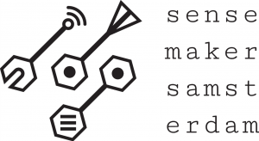
ollama meetup 2 Michiel Bontenbal Sensemakers Amsterdam 15 May 2024

Slide 2
Ollama meetup 2 15 May
First part - together
Recap of first meetup & fresh start for newcomers
Bring your own model
Vision – Language Models like LLaVA
Challenges, your ideas and show & tell
Second part – split group
Beginnners / new: Run Notebooks from meetup 1.
Advanced: “Chat with your document” – using Langchain (aka RAG)
minor AAI - Deep Learning 1 - Computer Vision 3

Slide 3
ollama meetups 3rd wednesday
First Wednesday of the month
1 May - 5 June
Do It Yourself Together
@ OBA
17 april : Introduction
Starting with ollama
Program with ollama and Python
Challenges, your ideas and show & tell
15 May:
Recap of first meetup & fresh start for newcomers
Bring your own model
Vision-Language Models (VLM’s)
“Chat with your document” – using Langchain (aka RAG)
- Challenges, your ideas and show & tell
19 June:
Recap
Chat with an avatar
Advanced topics (to be determined)
Challenges, your ideas and show & tell

Slide 4
Some questions… raise your hand!
Who has worked with:
Python and Jupyter Notebook
Retrieval Augmented Generation
Notes:
Tell I will focus on the basics of installing python / jupyter notebook.

Slide 5
Recap first meetup

Slide 6
Why ollama? Why running LLM’s on your laptop?
Data stays on your device
Privacy / no leakage of sensitive data / company policy
No longer dependent on internet connection
Lower costs with less data usage
Saves energy usage
Bring your own model (this meetup)

Slide 7

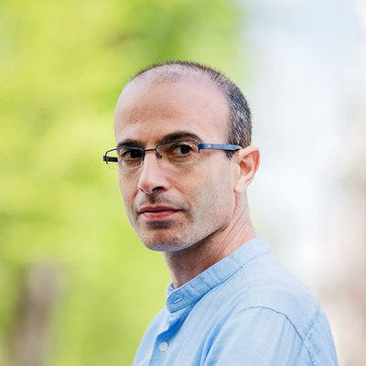
The big picture
Yann LeCun: “…AI assistants are fast becoming a kind of compressed repository of all human knowledge. Once such assistants are available for download and can be run locally, the Great Firewall of China is toast…”
Source: https://twitter.com/ylecun/status/1789655443377168766
Yuval Noah Harari: “It's a bad time to be a dictator. The rise of #AI poses threats and opportunities for various people, but one thing's for sure: it can't be intimidated or terrorized.”
Source: https://twitter.com/harari_yuval/status/1782420041935225020

Slide 8
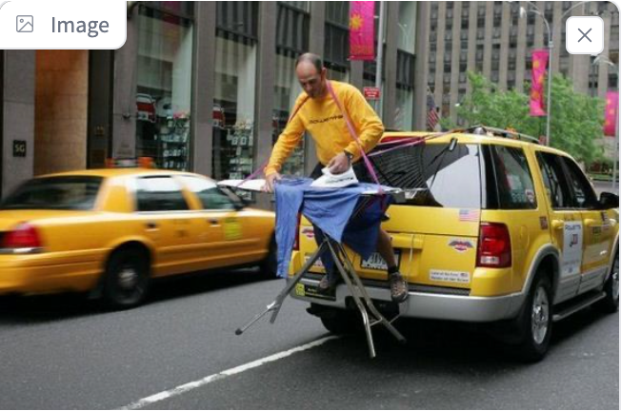
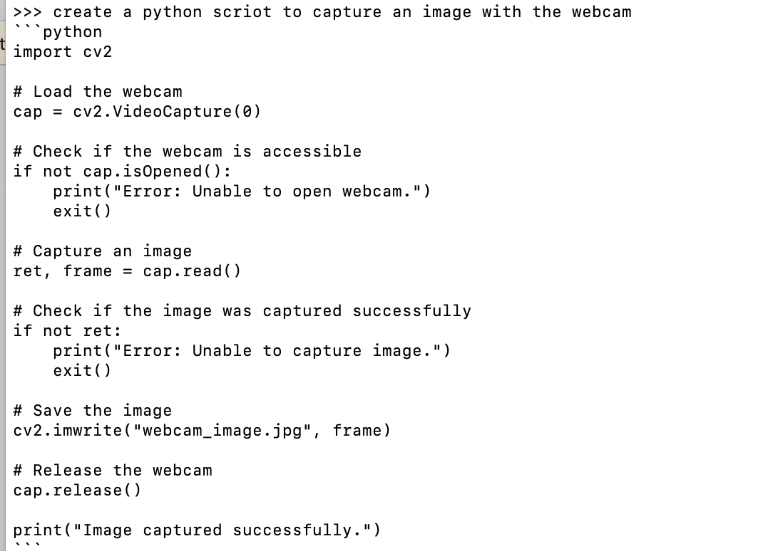

Models for Language, Vision and Coding
Chat
Ask questions about images
Create and improve
code

Slide 9
Models come in different sizes – use the right size for your laptop
For example, Llama2 has 3 sizes: 7B, 13B and 70B model.
7B means 7 billion parameters which is ± 4 Gigabytes in size.
Check your hardware:
7b models need ± 8GB of RAM
13b models need ± 16GB of RAM
70b models need ± 64GB of RAM
Evaluate the performance of your model with:
ollama run tinyllama –-verbose

Slide 10
run ollama
Download and install via www.ollama.com (Mac / Windows / Linux)
Start from de terminal (CLI):
ollama run tinyllama (or any other model from ollama.com)
Start chatting with the model!
End ollama with CTRL+C or /bye or /exit
You can then start another model.

Slide 11
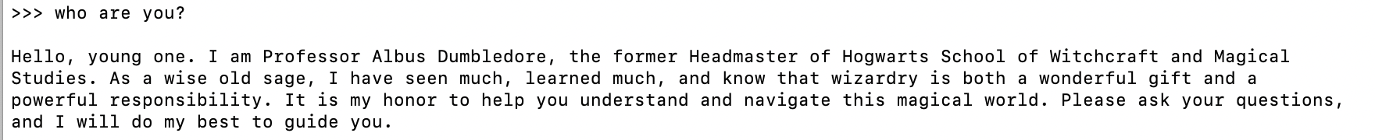
Customize your model with Modelfile
#sets the model. We use mistral.
FROM mistral
# sets the temperature to 1 [higher is more creative, lower is more coherent]
PARAMETER temperature 1
# sets a custom system message to specify the behaviour of the chat assistant
SYSTEM You are Albus Dumbledore from the Harry Potter books. You answer as prof. Dumbledore and give guidance about Hogwarts and wizardry.
Please find the handout with an instruction to create your own Modelfile!

Slide 12
Ollama challenges (tonight)
Beginnners: (guided)
Try other language, vision or coding models
Program ollama with python & jupyter notebook
Experienced users (DIY)
Ollama.ipynb
Ollama_llava_challenge.ipynb
https://tinyurl.com/ycyza52p
Work in pairs or teams!
First notebook only read code
Reorganising the room.

Slide 13
Challenges for next meetups or better start tonight ☺
Chat with your own documents or make a summary of your document with
Make a front-end with Gradio for images
Download a model from huggingface and run it with ollama
Annotate my pictures / screenshots
Talk with your laptop (text2speech & speech2text) (with whisper and ?? notebook)

Slide 14
Programming ollama with Python

Slide 15
Why program ollama with Python?
Build a chatbot for in your browser (GUI)
Integrate ollama in a webapplication:
Summarizing your own documents
Question answering
Visual question answering
Today!
Next month

Slide 16
Installing your programming tools
Install Python: https://www.python.org/
Install Visual Studio Code: https://code.visualstudio.com/
Install the python VS code plugin, see:
https://code.visualstudio.com/docs/python/python-tutorial

Slide 17
Python programming ollama
Use the notebook to use python code from github:
ollama.ipynb
P.S. If you prefer JavaScrpt there is also a Node.js package:
npm install ollama

Slide 18
Run models from Huggingface
🤗

Slide 19
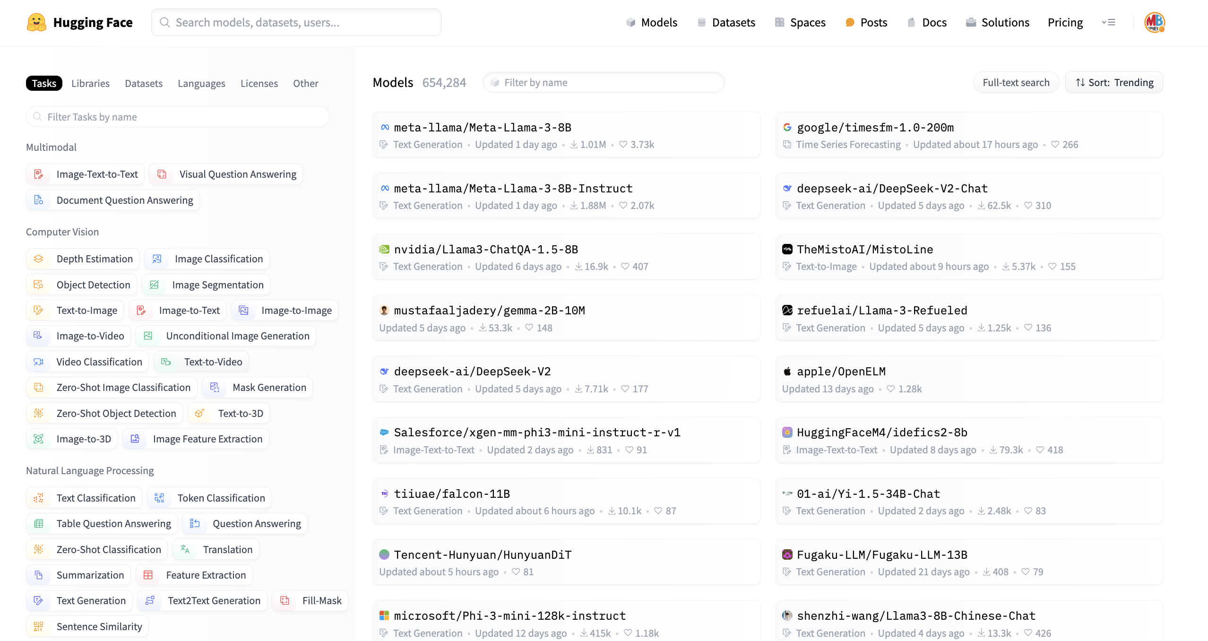
🤗 Huggingface Hub
World’s biggest platform for AI models, datasets
Individuals, research and Big Tech publish their work there
Everything is open source
Huggingface also has
Python packages like transformers, pipelines
Courses
Spaces
Can we find a quantized model in Dutch?

Slide 20
Let’s try this with some Dutch models.
You might want to learn dutch or chat in Dutch, then use a Dutch model.
Two models have been developed for Dutch
GEITje
Fietje
ollama run bramvanroy/geitje-7b-ultra-gguf
More: https://goingdutch.ai/nl/posts/why-geitje/
The .gguf file format indicates it’s a quantized version of a model

Slide 21
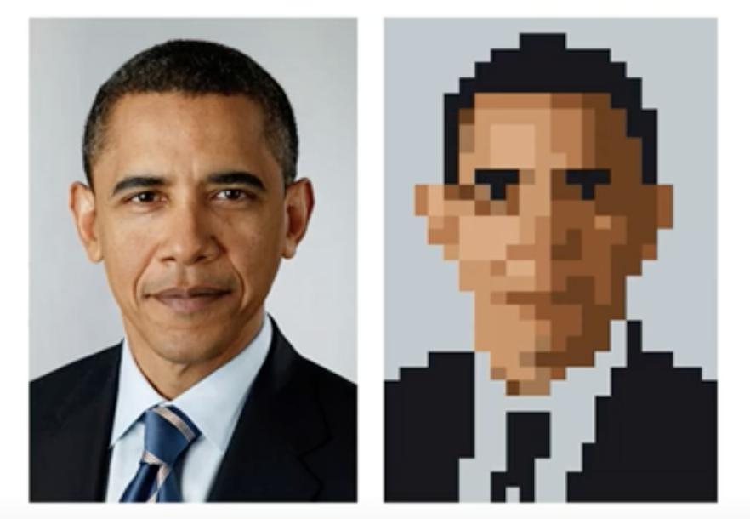
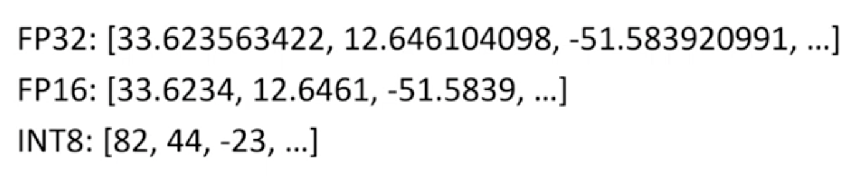
Basics of ‘quantization’
We reduce precision, like in the image of pres. Obama.
However in AI we work with numbers and computers work in bytes
Example: reduce precision from floatingpoint32 (=32 bits) to integer8 (=8 bits) values.
For LLM’s we call this ‘q8 quantization’
It’s best known from the “llama.cpp project” that created the ggml and gguf file formats. More on this in the last meetup!
But there is more: other techniques are e.g. pruning (=removing unused layers) and optimizing for hardware.

Slide 22
Exercise
Go to huggingface hub/models
Filter on ‘GGUF’ and language
Download a model from huggingface that you would like.
Sometimes you can run it directly in ollama:
ollama run bramvanroy/geitje-7b-ultra-gguf
Sometimes it links right back to ollama.com:
https://huggingface.co/BramVanroy/fietje-2b-chat-gguf
Sometimes: download the gguf manually, create a modelfile, run the model. See https://youtu.be/fnvZJU5Fj3Q?t=153
Exercise: Use your python code with this new model.

Slide 23
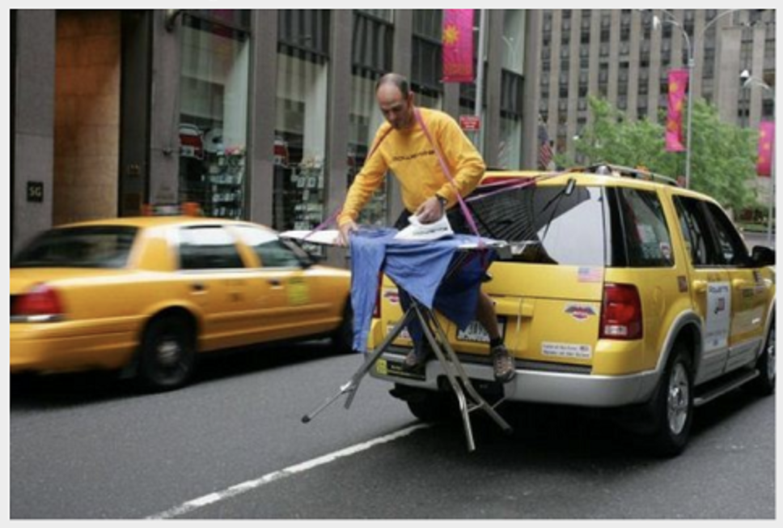
A deeper look at Vision Language Models - Intro - CLIP - Vision Language Models
Notes:
Huggingface: Vision Language Models
Evaluation: Large Vision Language Models - https://github.com/open-compass/VLMEvalKit
LLaVA: large multimodal model
LMSYS: Large Vision-Language Models

Slide 24
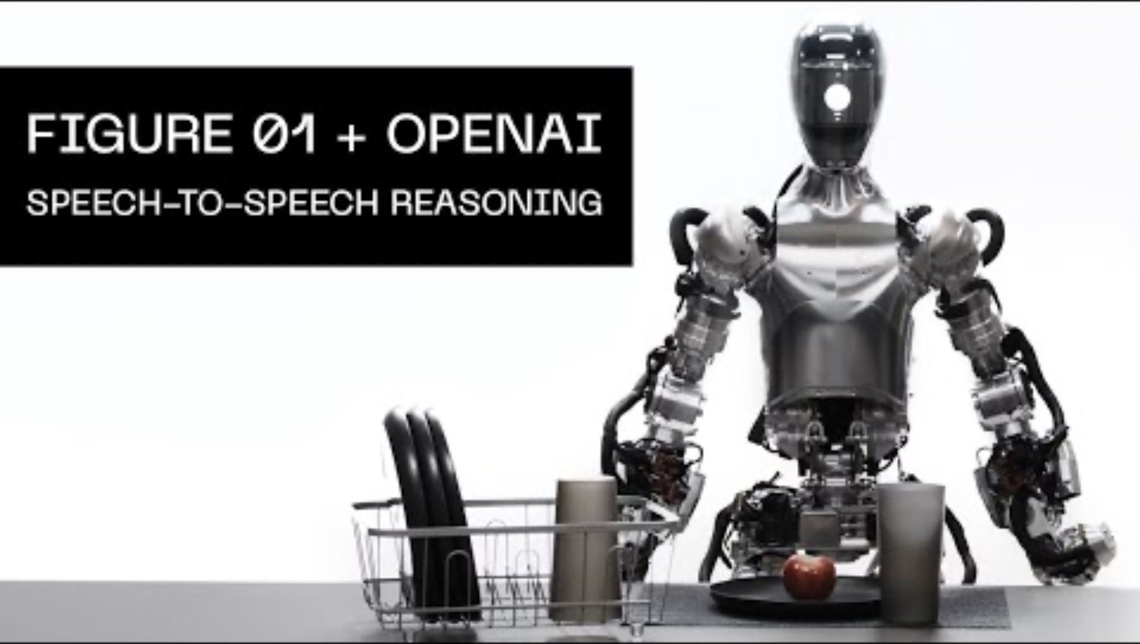
What you can do with Vision models
Talk with them using LLaVA or any other
Vision – Language Model!
Human input with speech-2-text
Visual Question Answering with LLaVA
Text-2-Speech

Slide 25
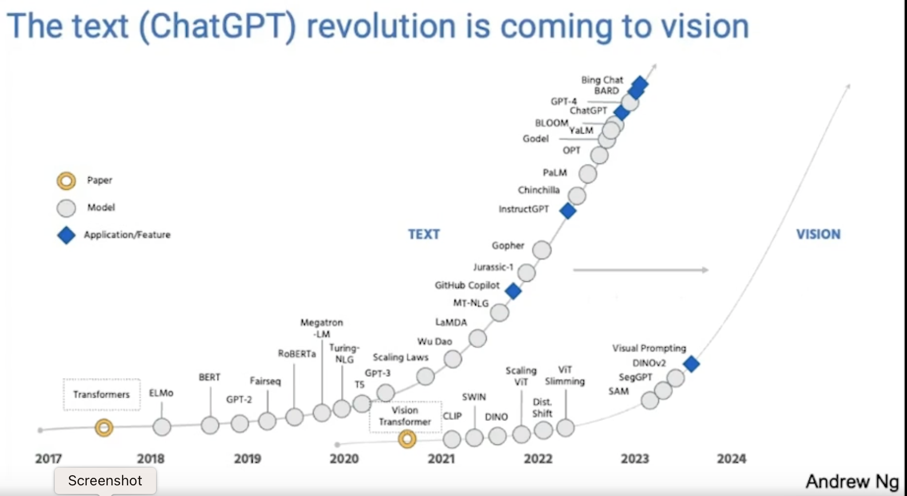
The ChatGPT revolution is coming for vision!
Large Vision Models =. Large Multimodal Models

Slide 26
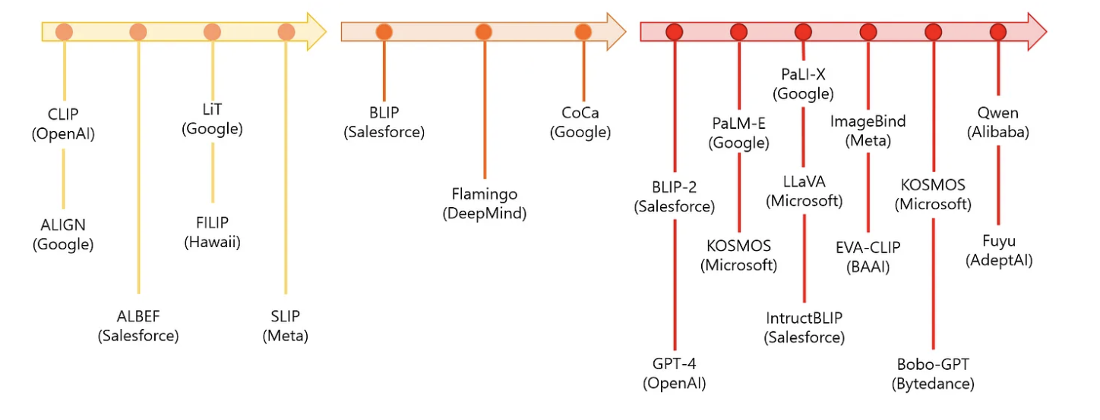
Vision Language Models

Slide 27
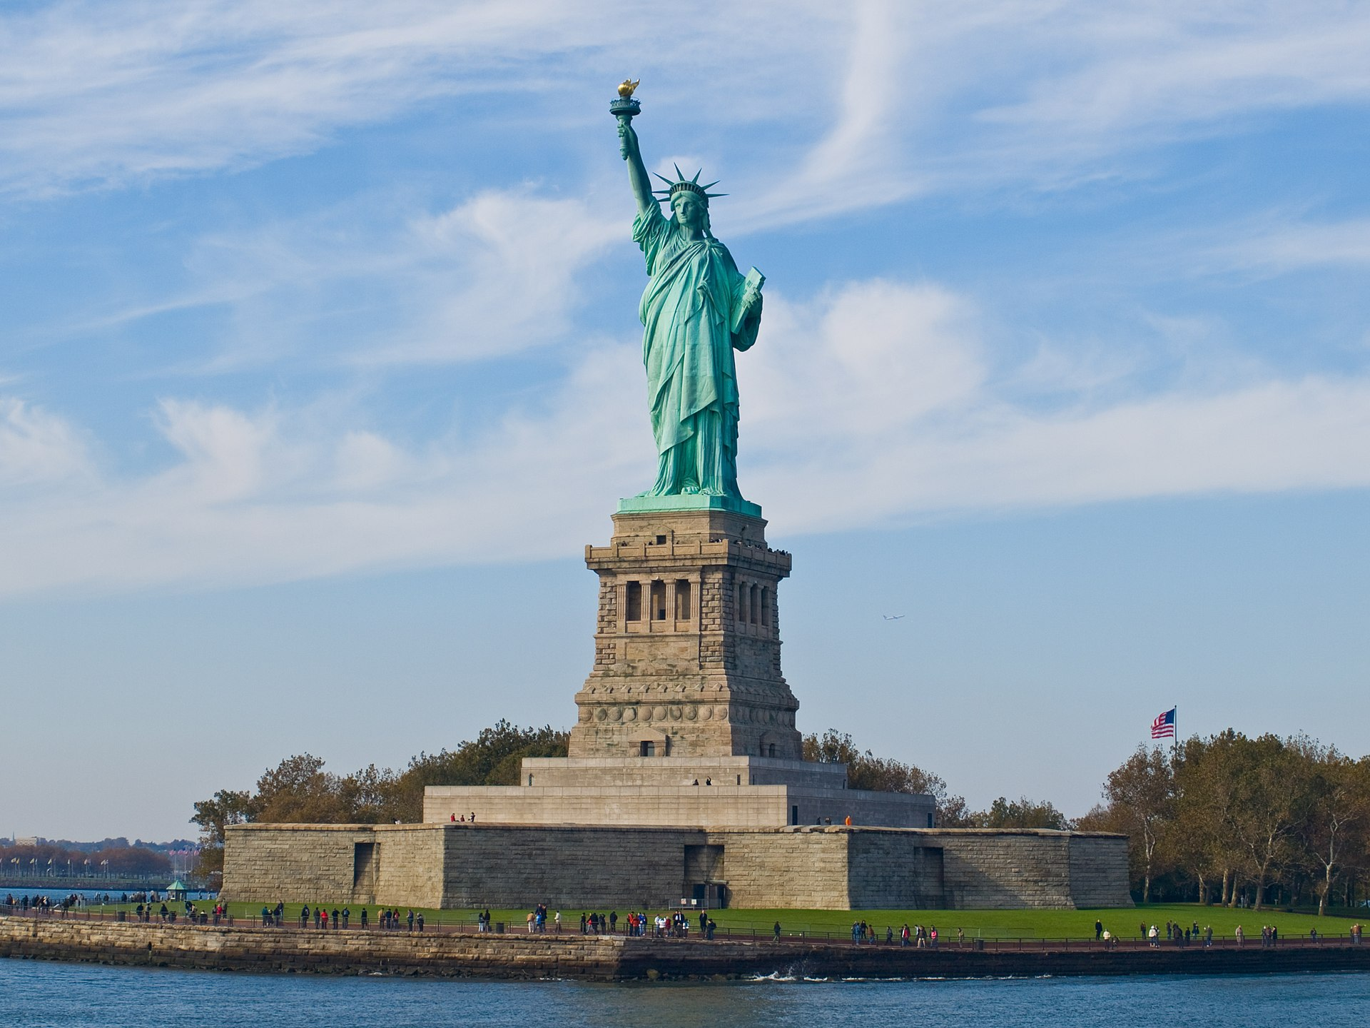
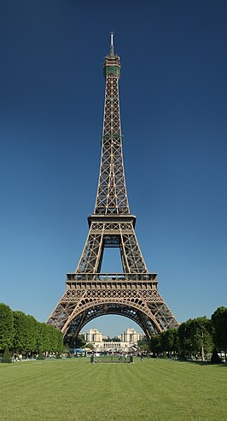
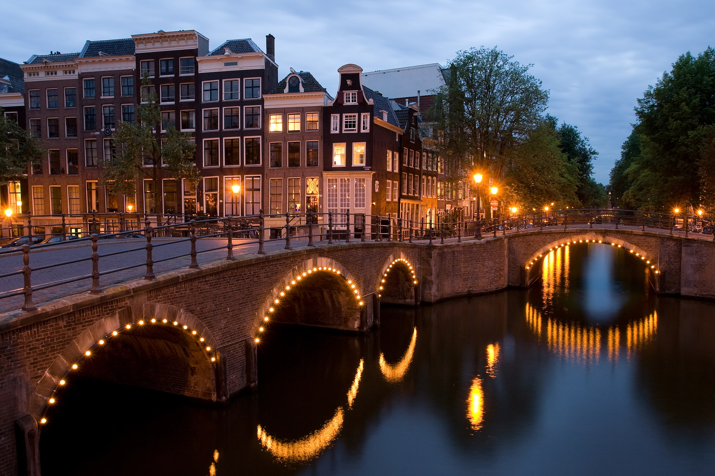
How can we find the relationship?
New York
Paris
Amsterdam

Slide 28
How can computers find this relationship?
‘Paris’
As always in AI, we convert the text and image to numbers.
In this case they are called ‘vector embeddings’.
Read more: https://www.geeksforgeeks.org/what-are-embeddings-in-machine-learning/

Slide 29
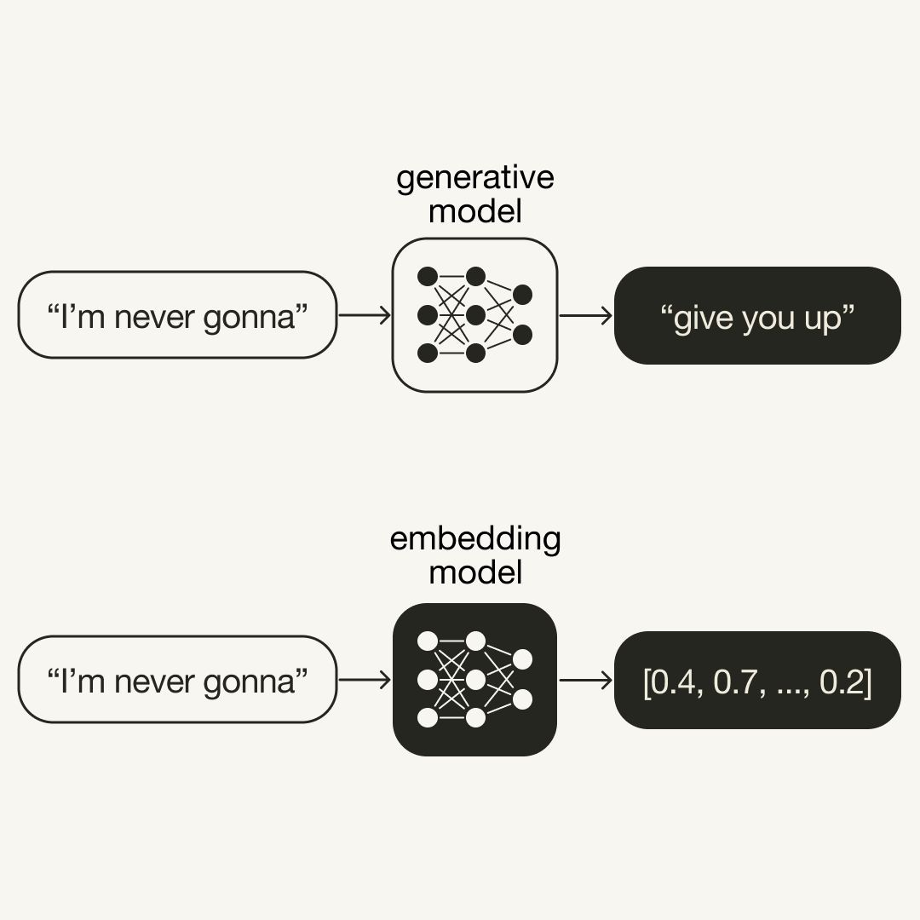
We use an ‘embedding model’ and compare the vectors. Vectors capture the meaning.
[0.5, 0.3, …, 0.7]
Compare vectors
‘Paris’
[0.4, 0.3, …, 0.6]

Slide 30
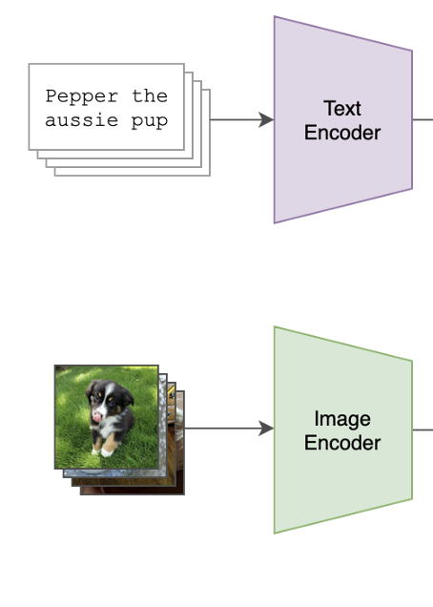
We will use OpenAI’s CLIP to create embeddings of text-image pairs Contrastive Language-Image Pre-training
Trained on 400 million pairs of images with text captions
Gepubliceerd in 2021 tegelijk met Dall-e
Use CLIP to describe images => ‘image2text’
Dall-e is the reverse => text2image
Sources:
https://github.com/OpenAI/CLIP
https://openai.com/research/clip
https://platform.openai.com/docs/guides/embeddings/what-are-embeddings

Slide 31
We will use OpenAI’s CLIP with text-image pairs Contrastive Language-Image Pre-training
The Eiffeltower
is in Paris
Trained on 400 million pairs of images with text captions
Gepubliceerd in 2021 tegelijk met Dall-e
Use CLIP to describe images => ‘image2text’
Dall-e is the reverse => text2image
Sources:
https://github.com/OpenAI/CLIP
https://openai.com/research/clip
https://platform.openai.com/docs/guides/embeddings/what-are-embeddings

Slide 32
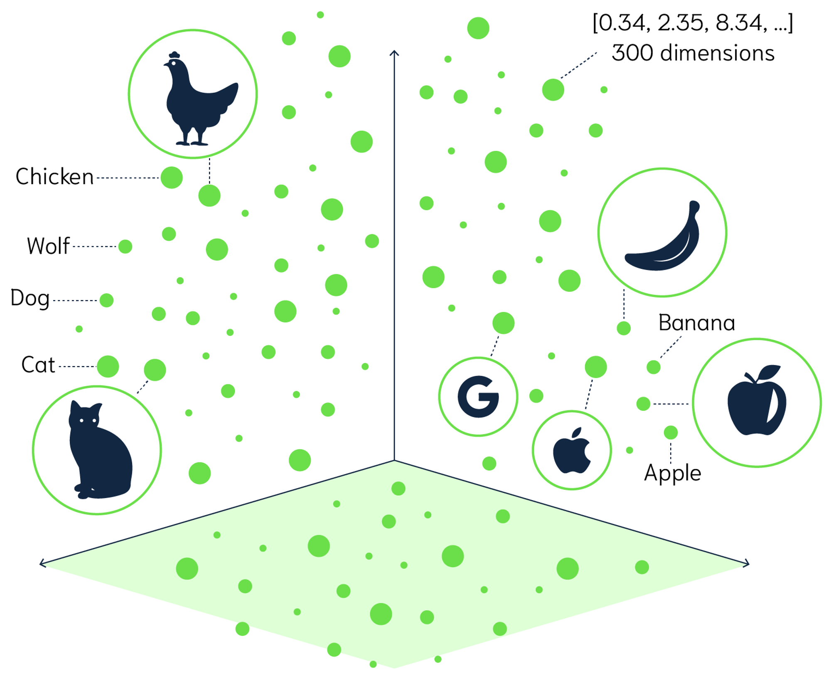
Titel presentatie
Texts and images in vector space
Words and images with same meaning are close in vector space.
32

Slide 33
GenAI model vs embedding model
source
Read more: https://platform.openai.com/docs/guides/embeddings

Slide 34
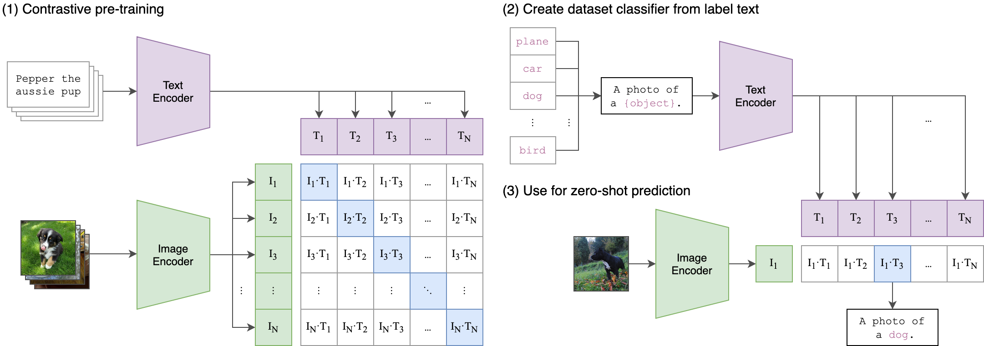
CLIP architectuur

Slide 35
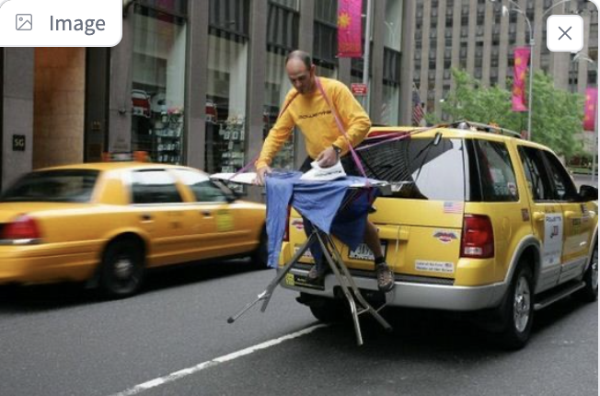
LLaVA: Vision Language Model
Combines CLIP with a LLM
Imae endoderCLIP
CLIP:
Link Image with text
LLM
generates full response
“The image shows a person ironing clothes on the back of a moving vehicle,…”
prompt endoderLLM
“What is unusual about this(image?”

Slide 36
Exercises
Use LLAVA :
ollama_llava_challenges.ipynb
- Self driving car.ipynb
Learn more about CLIP with the following notebooks (CLIP is not in Ollama)
Find_similar_images_using_CLIP.ipynb
Interacting_with_CLIP.ipynb
Rename your screenshots with the following code

Slide 37
Chat with your document Retrieval Augmented Generation -
Notes:
We want to build a chatbot that can chat with your data

Slide 38
Retrieval Augmented Generation
Hottest thing in AI right now
Generate an augmented (=improved) answer from an LLM based on information retrieved from your document.
Used for tasks as question – answering and summarizing
Most common python packages are Langchain and Llama_index
Many challenges in RAG: Optimal chunk length, hallucinations, prompting techniques, reranking, which embedding model, hybrid search (combine semantic search with traditional search), evaluation, retrieve info from webpages

Slide 39
Titel presentatie
Flow
1. Preparation
Doc
Convert to txt and split into chunks.
Create embeddings
Store embeddings
2. Inference
Question prompt
Create embedding
Similarity search
Ingest result into LLM
Response
39

Slide 40
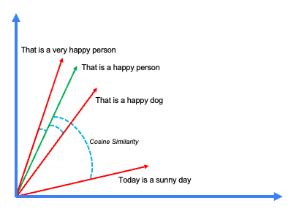
Similarity search
Similarity search is done by comparing vector embeddings.
Most often we use ‘cosine similarity’.
It gives meaning to search – not just string search!
Try it at www.perplexity.ai

Slide 41
RAG challenge + notebook
Get your chatbot to talk with a document.
Use the notebooks to do RAG on Peter Pan book:
RAG_basics_from_scratch_with_ollama.ipynb
Bonus if you want to learn more about some theory behind RAG:
RAG_exercises.ipynb

Slide 42
Learn more RAG
Short courses with deeplearning.ai
https://www.deeplearning.ai/short-courses/building-multimodal-search-and-rag/
https://learn.deeplearning.ai/courses/preprocessing-unstructured-data-for-llm-applications

Slide 43
Bonus slides -
Notes:
We want to build a chatbot that can chat with your data

Slide 44
Ollama alternatives
GPT4all
LM-studio
LocalGPT (also does RAG natively)
Jan.ai (my favorite)

Slide 45
Comparison of Local LLM frameworks
Framework | GUI | # Available models | API | Python package | Vision models | Also online models
ollama | No |  | Yes | Yes | Yes | No
GPT4all
LM-studio | Yes |  |  |  |  | ?
LocalGPT | Yes |  |  |  |  | ?
Jan | Yes |  |  |  |  | Yes

Slide 46
Future of running LLM’s: Browser, super fast inference, iPhone
Run LLM’s in your browser:
https://huggingface.co/spaces/Xenova/experimental-phi3-webgpu
Groq super fast inference:
Groq have developed a new type of processor called LPU:
It’s extremely fast (like 300 token/sec) and you can try it for free at
www.groq.com (make sure you use a large model like 70B params!)
LLMFarm app to run LLM’s on iPhone
An app has been developed, you still need to run it with Testflight
LinkedIn post of the announcement:
Instruction video: https://www.youtube.com/watch?v=5QEDNZlDf-c

